Slide 1
DCDP 2018 SDR Presentation
2018 Digital Content Delivery Platform

Slide 2
Agenda – 2018 DCDP Project
Topic | Presenter | Time
Introduction | Rob Hill | 10
Project Management | Jasmine Danielli | 10
Product Overview | Marcin | 10
SE Architecture Overview | Paul Van Vleck | 10
Ad Insert | Jillian Abeyta | 10
APG | Vu Dang | 10
Load Test | Emi Melena | 10
DCDP UX | G Sinha | 10
Lunch | 11:30 – 12:30PT | 60
PDS | Vishnu Kothur | 20
Production Validation and Testing (PIT) | Srivatsan Venkatesan | 10
Genie Set Top Box | Ringo Ling | 20
STB NEL Team | Talon Jones | 10
CPE E2E – Interactive App Test Team | Jerome Ronquillo, Danilo Resurreccion | 10
E2E Functional | Srinivas Chenna/Rishabh Chandra | 10
Advanced Technical Services | Leo Anderson | 10
CPE E2E Performance Test | Abhijit Agashe | 10

Slide 3
DCDP SDR Presentation
EPMO
Jasmine Danielli

Slide 4
Schedule / Critical Milestones
MILESTONE | TARGET DATE
SDR | 9/1/17
Team ROM10s due to EPMO | 9/7/17
DG2 | 9/29/17
HE Iteration 14 or later | Q2 2018
Labor Day Holiday | 9/4
STB – Alhambra | Q4 2018
Integration | 04/16/18 - 07/06/18
Final Bug Report | 08/17/18
NEL Delivery | 09/14/18
National Release | Q4 2018
Release | Dec 2018
Feature Delivery: Dec 2018
HE:
BAU I14 (Q2 2018)
DFW PIs (schedule forthcoming)
STB: Alhambra (Q4 2018)
Team LOES/ROM10 Due: 9/7/17
General Information
MP00005919
CFAS: A0101RT
PMATT: 256301
Project PMATT Site: http://pmatt.it.att.com/itg/project/ViewProject.do?projectId=190821
Project Documents: http://pmatt.it.att.com/itg/project/ViewProject.do?projectId=190821&projectView=projectReferences&IS_WINDOID=N

Slide 5
DCDP SDR Presentation
Product Overview
Marcin Spatzier

Slide 6
DCDP 2018
Support for DCDP feature set on HR44+ and clients as well as HS17 legacy platforms
Support for OTT delivery of live and VOD content from DFW headend to legacy platforms
Support for content discovery via Guide, Search, and interactive TV experiences on legacy platforms
Ability to launch OTT content’s playback from the Guide, Search, and interactive TV experiences on legacy platforms
Ability to launch interactive apps from the Guide, Search, and interactive TV experiences (EE) on legacy platforms
Availability of restart and 72-hour lookback of streaming content on legacy platforms
Availability of DRM solution for OTT content on legacy platform
Support for recording of OTT content on legacy platforms
Support for ad insertion for OTT content on legacy platforms
Availability of Closed Captioning for OTT content on legacy platforms
Support for Talking Guide integration with interactive experiences
Support for development efforts associated with branded micro-apps and their integration with Entertainment Extras
Availiability of reporting

Slide 7
DCDP SDR Presentation
SE Architecture Overview
Paul Van Vleck/Rob Hill

Slide 8
SE Architecture Overview

Slide 9
DCDP SDR Presentation
Ad Insert
Jillian Abeyta

Slide 10
Impacted Systems for Live platform
Impacted System | Function
Content Provider | Identify DAI eligible ad breaks with SCTE-35 messages. Ensure scte-35 signaling is compliant to the DTV specification (no splice immediate, duration with break start)
Harmonic VOS Encoder | Support ESAM interface to the EMMS system stream conditioning to ensure IDR frames at scte-35 trigger boundaries
YoSpace EMMS | Scte-35 normalization to DTV house format. Template creation for new channels
Harmonic VOS Packager | Segmentation of the MPEG-DASH stream in to multi-period DASH at Ad Boundaries based on scte-35 triggers. Base-64 annotation of raw scte-35 payload as stream events
YoSpace Pull/Push | Pulls/pushes DASH MPDs to YoSpace CSM receiver on the cloud
YoSpace CSM Receiver Origin | CDS stream configuration for new live channels Usage profile for STB streaming profiles; CALM compliance on transcoded ads
POIS/TDS | (optional) if advanced UPID extraction is needed for live streams

Slide 11
Impacted Systems for Live platform
Impacted System | Function
FreeWheel MRM | Traffics Ad URLs from ADR into MRM system Delivers Ad URLs to client via ADR and CSM Edge
DTSS/DLS/PDS | Support new Live DAI eligibility flag for STB linear channels. Provide DAI eligible flag to STB client per channel
CDNM | Return YoSpace CDN URL and media base CDN URL to the STB clients
STB | Identification of DAI eligible content from PDS Get content URL from CDNM Create the YoSpace stream request URL with additional DAI parameters Build the YoSpace analytics library for STB platform that includes CSM edge analytics communication VAST parser Timed metadata event receiver Impression reporting Trick mode management STB player to support multi-period DASH and timed metadata extraction from DASH streams Integrate Nielsen TVR SDK for instream event reporting

Slide 12
Impacted Systems for the VOD platform (BAU)
Impacted System | Function
Content Provider | Deliver VODcontent with ADI.XML metadata file with key advertising parameters like Ad Content ID Ad Break metadata
Aspera | New VOD drop location
CMS | New Service Category for provider Configure FreeWheel network ID for content owner
ATEME | BAU
VSPS | BAU
FreeWheel | Configure network partnership between AT&T MRM and provider MRM Configure share of voice business rules Provider MRM to enable YoSpace Ad transcoding service (?)
DLS/PDS | BAU
STB | BAU

Slide 13
Advertising
Assumptions
No DVR ad insertion (Zone/HIC and Aggregation)
No DAI ad insertion on API-delivered streams
Support DAI ad insertion model via BB delivered content
Addressability to be achieved via DFW integration
Satellite channel offloading only for non-Addressable satellite channels
STB can play standard MP4 content similar to what is currently delivered to DFW un-managed clients using MPEG-DASH
Nielsen TVR and DAR reporting are required
STBs shall support dynamic FreeWheel site section at granular (content provider level)
Yospace shall support CBPs
CALM Act compliance is required
Fallback ad support is required

Slide 14
Advertising
Supported Ad insertion types:
Live DAI (via Ad Decision Router, Yospace and FreeWheel)
VOD DAI (via Ad Decision Router, Yospace and FreeWheel)
Server Side Ad Insertion model using Yospace CSM and Yospace SDK

Slide 15
Questions:
Are there any API-delivered Live channels or everything is sourced from DFW feeds?
Does Nielsen reporting is required (Nielsen tags (ID3/EMSG) vs. Nielsen audio watermarks)?

Slide 16
APG-HE
Vu Dang

Slide 17
APG-HE: New Service Type for OTT Channels
Configuration for OTT channels will support:
New service type
URL for content or iTV application
MIME type to define streaming, e.g. DASH/MP4/AES-CTR/Widevine
Based on current System Spec, OTT Channel Configuration to be provided by DTSS
OTT Channel-Related Image
Generic/specific OTT channel-related images
Questions:
“Referenced” or “Un-referenced” HTTP Object/Graphics Object (HO/GO)?
Which system will provide the image associated to the channel(s)?
How will the channel(s) be associated to the image?
Bandwidth Projection on OTT Channels and Channel-Related Images
How many OTT channels?
How many images?
Size of the images?
Cycling frequency?

Slide 18
DCDP SDR Presentation
Load Test
Emi Melena

Slide 19
Production Load Test
HE systems-PDS
Load testing to validate expected load as per specs:
Average Number of Unique Users at Peak Sessions (200K)
All unique concurrent users

Slide 20
DCDP SDR Presentation
DCDP UX
G Sinha

Slide 21
DCDP 2017 – Quick Recap
Linear Channel Augmentation
(channels in guide, video playback…)
Note : No program info displayed in the guide row for the short term, due to technical limitations.

Slide 22
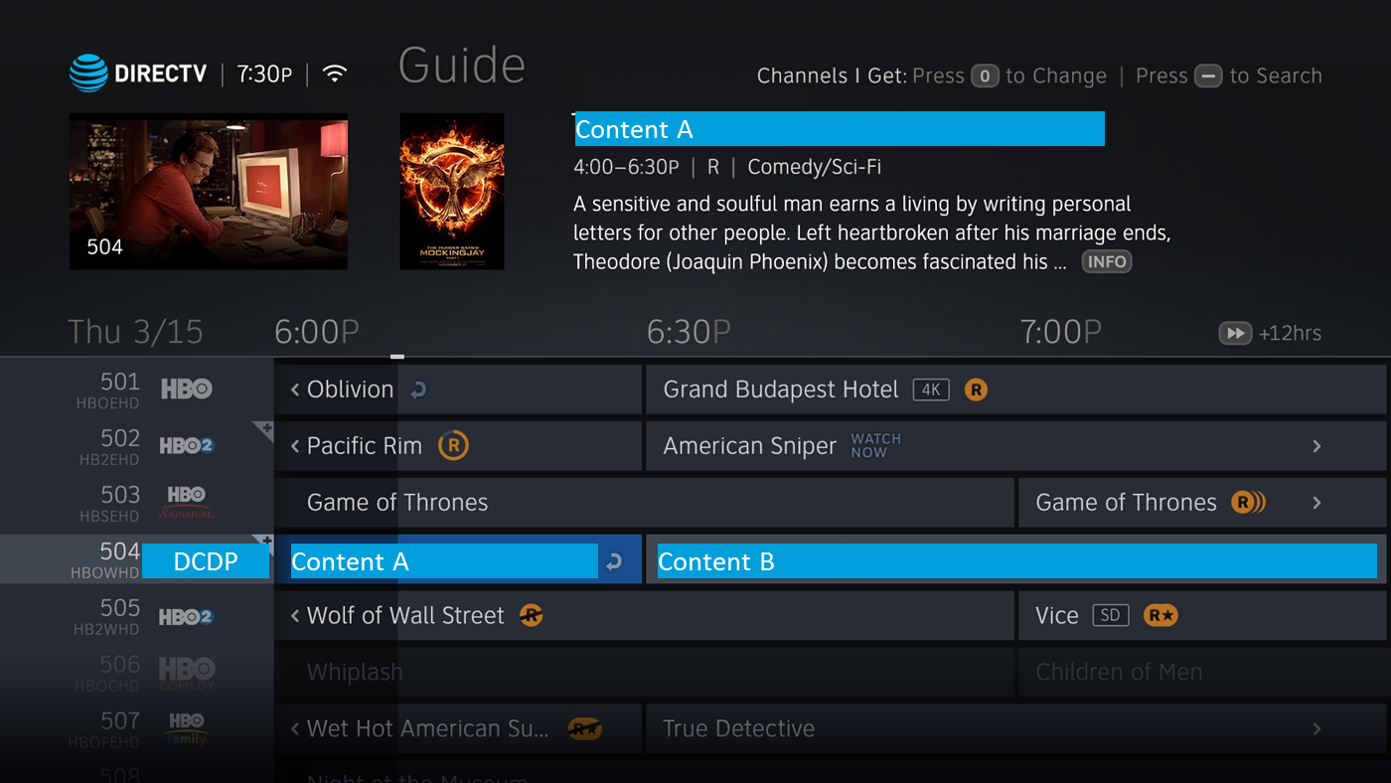
Ingesting metadata for DCDP content and presenting it in the guide.

Slide 23
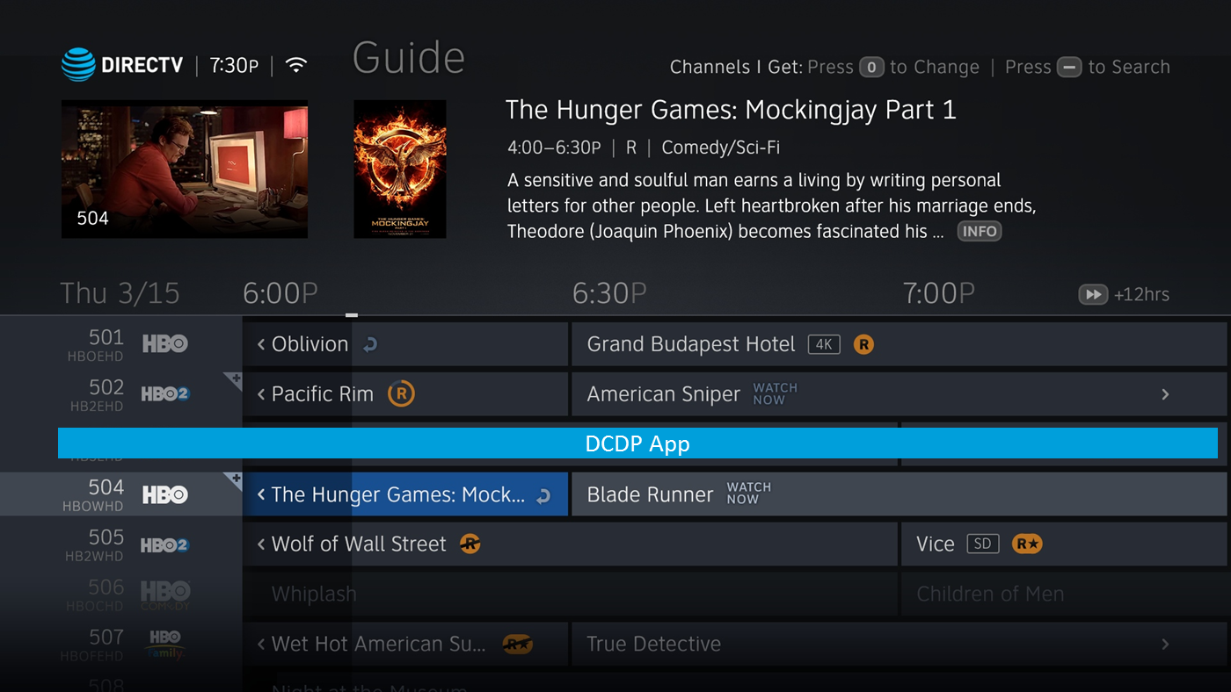
Deep linking from the guide into an App
The intent is to either launch directly into an app or deep link to a specific location within the app.

Slide 24
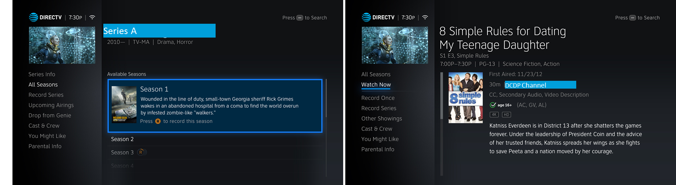
Info Screen for Series and Episodes for DCDP content
In scenarios where the existing patterns cannot be followed (like Record), additional messaging will be presented.

Slide 25
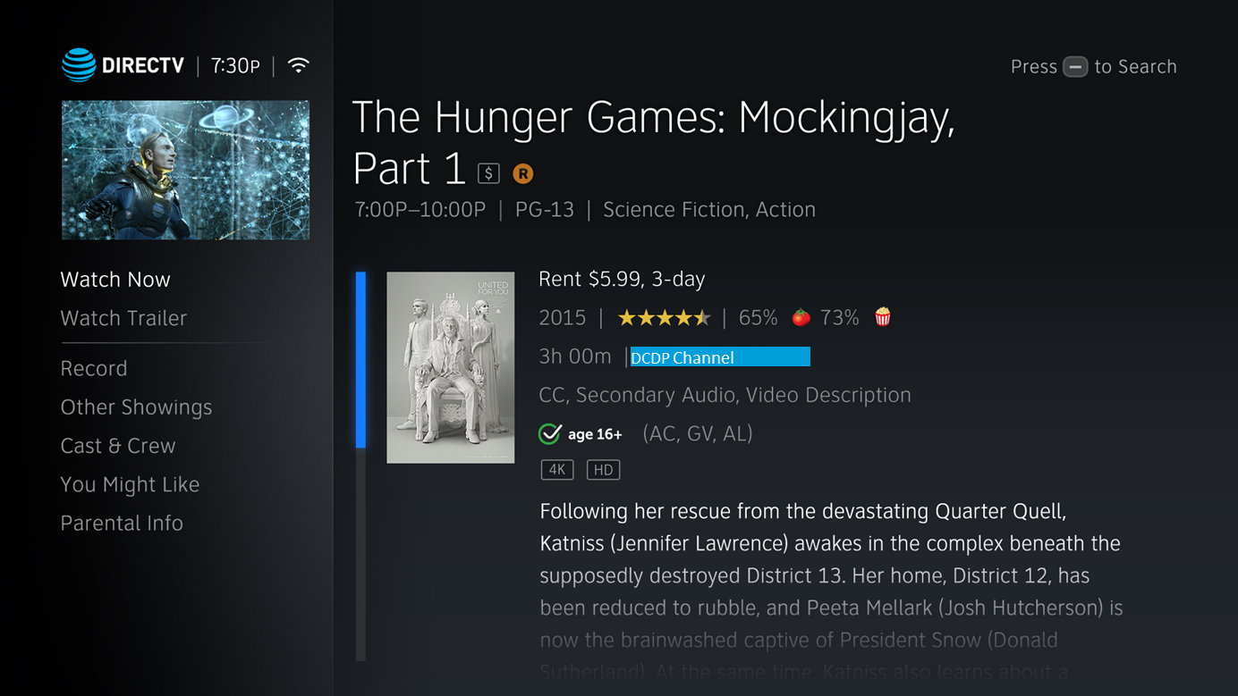
Movie Info Screen

Slide 26
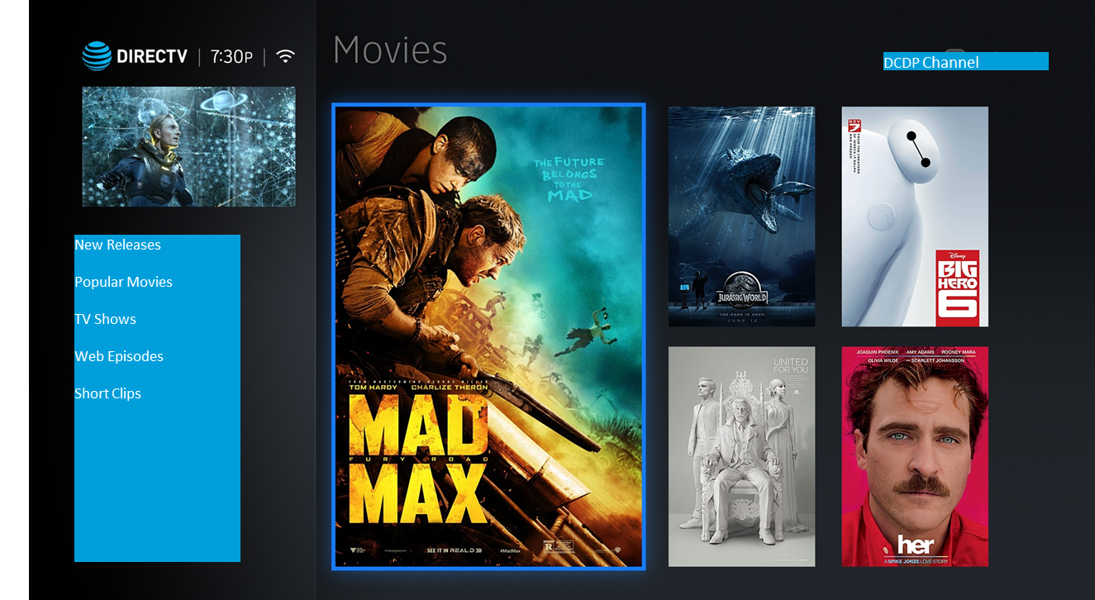
VOD Home Pages

Slide 27
Ideally, this content will follow the existing logic for subscription, pay-per-view, parental controls, favoriting a channel, recording a content etc.
In scenarios where the content cannot adhere to the existing logic, additional messaging will be presented on the screen.

Slide 28
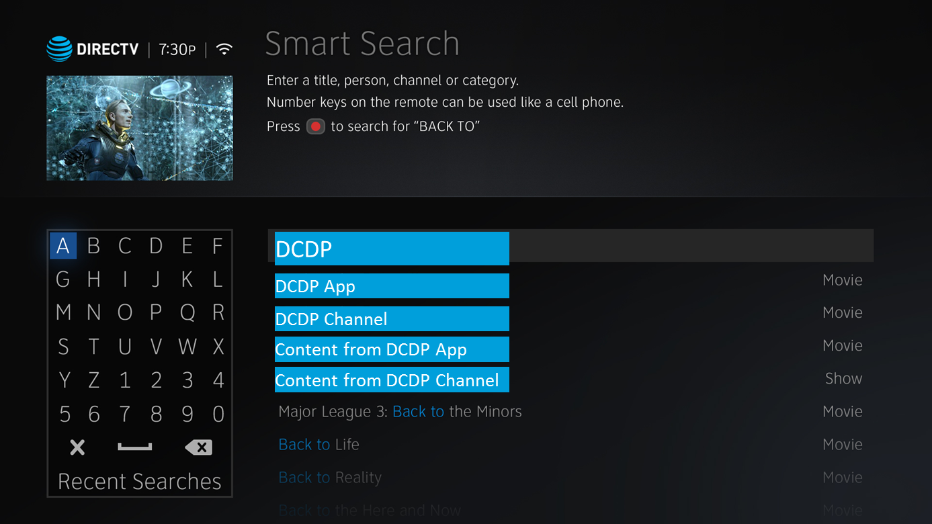
Smart Search
Smart Search will display results based on metadata ingested. This could include one or a combination of the following…
DCDP app
DCDP linear or VOD channel
Content from either DCDP app or channel.

Slide 29
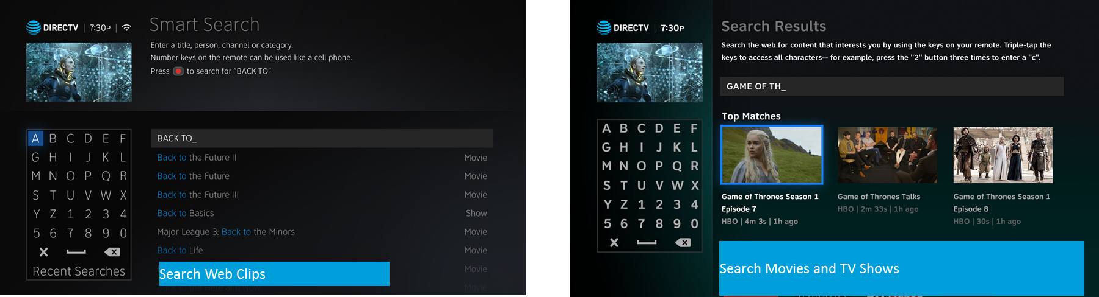
Cross Linking between Entertainment Extras Search and Smart Search
Smart Search will provide an access point into Entertainment Extras’ search results, and vice versa.

Slide 30
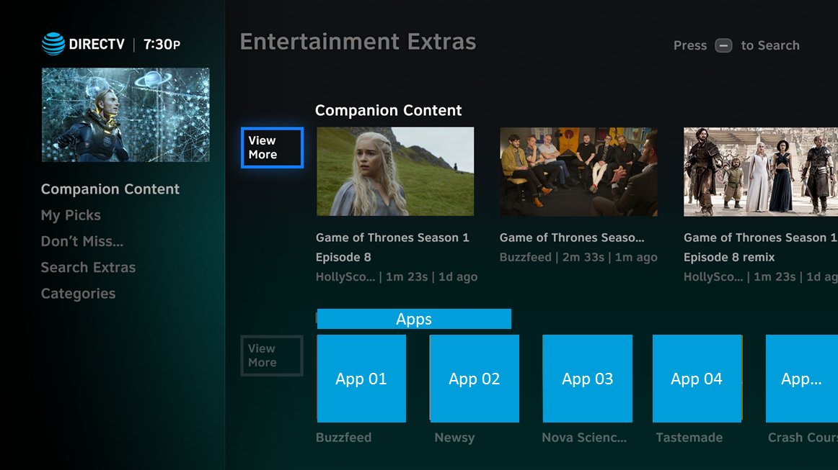
Apps in Entertainment Extras’ Homepage
Entertainment Extras will house additional apps.
The design effort for this is to be led entirely be Frequency.

Slide 31
DCDP 2018 SDR Presentation
Program Data Services (PDS)
Vishnu Kothur

Slide 32
Presentation Items
PDS Data Flow Diagram
Features and Impacted Services
PDS-SD: Search and Discovery
PDS-GL: Guide Locator
PDS-VL: Video Locator
Questions and Answers on the Presented Material

Slide 33
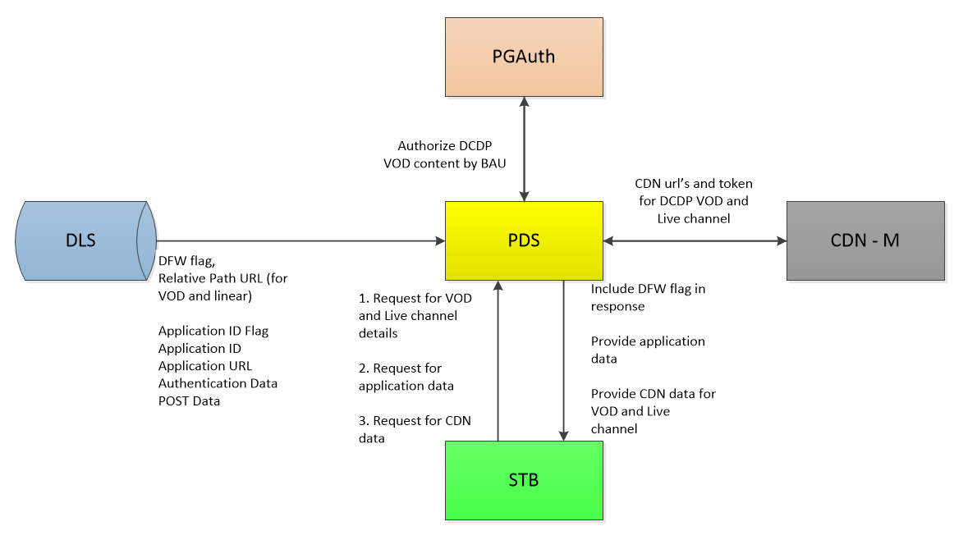
PDS Flow Diagram

Slide 34
Features and Impacted Services
Requirements applicable to PDS-SD and PDS-GL:
[R27] PDS will obtain VOD OTT catalog data from DLS that will be updated to include an indicator that the content is being hosted by DFW and the URL referencing the content.
OPEN QUESTION: Is this requirement extended to Live OTT content (only “VOD OTT” is listed in the requirement)? Will DFW also host live channels?
[R28] PDS will provide an update to the VOD catalog data presented to STBs that will include a flag indicating the asset is hosted by DFW and a URL referencing the content.
NEED REQUIREMENT UPDATE: Need a separate requirement; URL is not provided in the same request for VOD data. PDS-SD/search and PDS-GL/contents supply content data (with the addition of the DFW flag); PDS-VL/cdn supplies the CDN URL information.
[R29] PDS shall provide a service to map both channel ID and application IDs to URLs.
Note: The Client should use PDS-SD/search or PDS-GL/contents to retrieve application data. The Client should use PDS-VL/cdn to retrieve CDN data for VOD and Live OTT channels (File Path, CDN Token, URL Prefix, Post URL).
[R30] The service shall support accepting an array of channel and application IDs and returning an array of mapped URLs.
NEED REQUIREMENT UPDATE: Arrays are no longer necessary. PDS will not support arrays of CCID’s, Material-IDs, and application-ID’s in the request.
[R31] The service shall receive the data to perform the mapping from DLS.

Slide 35
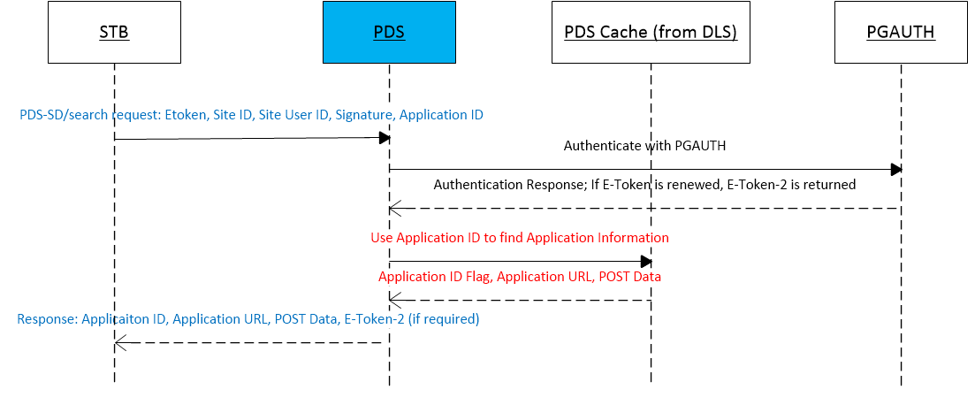
Features and Impacted Services
PDS Search and Discovery Services
Enhancement: Providing Application Data
An optional request parameter will be added to the PDS-SD/search service for the Application-ID.
If the Application-ID is provided in the request, PDS will provide the application data that is provided by DLS: Application-ID Flag, Application URL, POST Data.
OPEN QUESTION: Does authentication data need to be provided for this use case?
From section 6.3 in the system spec, DLS will provide PDS authentication data for the application.

Slide 36
Features and Impacted Services
PDS Search and Discovery Services
Enhancement: Providing a DFW indicator flag
DLS will provide the DFW flag which indicates whether the content is served by DFW.
The PDS-SD/search service will provide a DFW flag as part of the material details.
OPEN ITEM: If DFW is hosting Live OTT channels, PDS will provide the DFW flag as part of the schedule details.
Assumptions:
PDS expects the URL (meaning relative path) to be provided in the live OTT channel data provided by DLS.
The ability to search for an ‘application’ via Smart Search, Category Search, and Keyword Search is not applicable for the 2018 DCDP project.

Slide 37
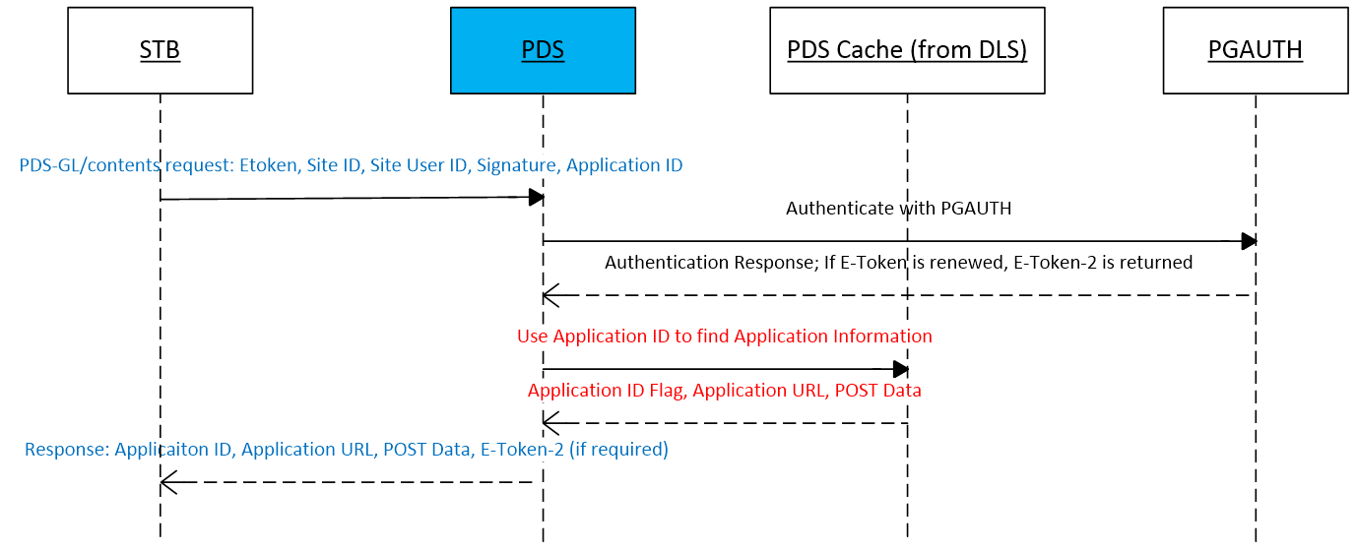
Features and Impacted Services
PDS Guide Locator Services
Enhancement: Providing Application Data
An optional request parameter will be added to the PDS-GL/contents service for the Application-ID.
If the Application-ID is provided in the request, PDS will provide the application data that is provided by DLS: Application-ID Flag, Application URL, POST Data.
OPEN QUESTION: Does authentication data need to be provided for this use case?

Slide 38
Features and Impacted Services
PDS Guide Locator Services
Enhancement: Providing a DFW indicator flag
DLS will provide the DFW flag which indicates whether the content is served by DFW.
The PDS-GL/contents service will provide a DFW flag as part of the material details.
Assumptions:
BAU pay-per-view flow is extended to DFW VOD content.
PDS expects the URL (meaning relative path) to be provided in the live OTT channel data provided by DLS.
The ability to search for an ‘application’ via Smart Search, Category Search, and Keyword Search is not applicable for the 2018 DCDP project.

Slide 39
Features and Impacted Services
PDS Video Locator Services
Requirements related to PDS VL:
R29] PDS shall provide a service to map both channel ID and application IDs to URLs.
Note: The Client should use PDS-SD/search or PDS-GL/contents to retrieve application data. The Client should use PDS-VL/cdn to retrieve CDN data for VOD and Live OTT channels (File Path, CDN Token, URL Prefix, Post URL).
[R30] The service shall support accepting an array of channel and application IDs and returning an array of mapped URLs.
NEED REQUIREMENT UPDATE: Arrays are no longer necessary. PDS will not support arrays of CCID’s, Material-IDs, and application-ID’s in the request.
[R31] The service shall receive the data to perform the mapping from DLS.
[R32] PDS shall proxy requests from the STB to the CDN Manager.
Note: Existing Functionality. Client should use PDS-VL/cdn for CDN data.
[R33] PDS shall receive from STB the URL needing to be updated.
NEED REQUIREMENT UPDATE: STB will provide the CCID or Material-ID along with the mandatory request parameters for PDS-VL/cdn.
Note: Refer to the section 5.1 Get CDN Data Service in the PDS ICD for more details.
[R34] PDS shall make a call to CDN Manager to obtain an updated CDN token and CDN selection.
[R35] PDS shall return the new URL to the STB.
Note: PDS will return the data through the existing response parameters.

Slide 40
Features and Impacted Services
PDS Video Locator Services
Enhancement: Updating the logic for Live content CDN requests
For a VOD and Live OTT channels, PDS will retrieve the relative path from the metadata provided by DLS. The relative path is used to call the CDN Manager for the CDN data (File Path, CDN Token, URL Prefix, Post URL).
PDS will support receiving the PDS-VL/cdn request from either the STB or iTV/Launcher App. Therefore, the authentication parameters (E-token, Site ID, Site User ID, Signature) and Access Card ID/CAM-ID may come as request parameters OR within an HTTP cookie respectively.
OPEN QUESTION: Will iTV/Launcher app still be the client for 2018 DCDP? If not, PDS will expect the authentication parameters and CAM-ID as request parameters only.
Some functionality developed in the DCDP 2017 project will no longer be required: Retrieving the relative path from the PDS configuration file.
Assumptions:
CAM-ID will be provided to PDS by the STB when attempting to stream live OTT channels.
Service = ‘dodac’ is acceptable for DTV VOD and DFW VOD.
Service = ‘dcdplive’ is acceptable for 2017 and 2018 (including DFW OTT) DCDP live channels.
OPEN ITEM: Pending confirmation whether DFW will host OTT live channels.

Slide 41
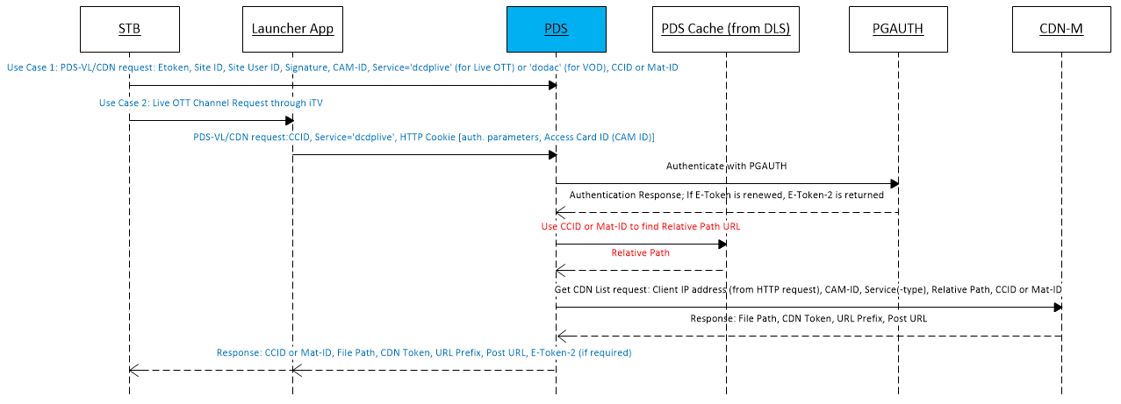
Features and Impacted Services
PDS Video Locator Services
Enhancement: Updating the logic for Live content CDN requests

Slide 42
Features and Impacted Services
PDS Video Locator Services
Supported Use-cases:
Use Case No. | Client | Request | Response | Notes
UC-1 | STB | Material-ID, Service = ‘dodac’, E-token, Site ID, Site User ID, Signature, CAM ID | CDN data for VOD | Since inception
UC-2 | iTV/Launcher App | CCID, Service = ‘dcdplive’, HTTP token [E-token, Site ID, Site User ID, Signature, Access Card ID (CAM ID)] | CDN data for Live | Implemented in DCDP 2017
UC-3 | STB | CCID, Service = ‘dcdplive’, E-token, Site ID, Site User ID, Signature, CAM ID | CDN data for Live | New for DCDP 2018; need confirmation on client.
UC-4 | iTV/Launcher App | Material-ID, Service = ‘dodac’, HTTP token [E-token, Site ID, Site User ID, Signature, Access Card ID (CAM ID)] | CDN data for VOD | New for DCDP 2018; need confirmation on client.

Slide 43
Features and Impacted Services
PDS Video Locator Services
Existing Functionality: Support CDN token refresh
Assuming that the STB needs an updated CDN token from the CDN Manager (via PDS), the STB can use the existing PDS-VL/cdn service to retrieve an updated CDN token.
Therefore, no additional PDS code change is required for this requirement. The previous enhancement (slide 11) can be leveraged using a CCID or Material-ID to get the packet of CDN data, which includes the CDN token.
The STB must provide a CCID or Material-ID. Earlier discussions stated that a URL may be provided to PDS to refresh the token; however, that is no longer valid.
Note: Please refer to the PDS ICD section 5.1 Get CDN Data Service for more details on this service including the expected request and response parameters.
OPEN QUESTION: Will a request to PDS to refresh the CDN token come directly from the STB or from the iTV/Launcher Application?

Slide 44
DCDP 2018 SDR Presentation
Production Validation and Testing
Srivatsan Venkatesan

Slide 45
Overview
Objective
Perform end-to-end testing in the Production environment
Verify all functional requirements for DCDP as detailed in the System spec.
Scope
System Flow Testing: Verify environment integration and check overall system flow
Detail Functionality Testing: Verify the test cases and requirements identified in the system spec and PIT test plan
Test Platforms : HR44, HR54 and HS17
Impacted Components: PDS ,CMS , DTSS
Deliverables
The final test plan
A test report including all test results and issues observed during system testing

Slide 46
Pre-requirements
Initial set up ready with all systems in place in the advertising test environment in production
PI and E2E System Test Reports
Updated Systems Specifications Document
Head-end system access (as required)
Point of Contact from different teams for support
STBs for testing
Identify the shadow channel to be available in new infrastructure for testing

Slide 47
System Integration Testing
Verify the environment integration of the components below
Linear channel ingestion flow from Mission facility
Content Provider -> Encoders -> Origin Server
Linear channel Play back from DTV STB
STB -> PDS-> CDN -> Origin Server
Metadata Flow
DTSS -> DLS-> PDS -> STB

Slide 48
Functional Testing
Verify Live Channel information on STB
Verify live content can be discovered via the below option:
Guide
Search
Surf
Verify the application launcher is initiated while user selects live streaming channel
Verify live stream plays back
Verify the CATO requirements
Regression Testing
Create a new VoD asset using existing LABC infrastructure
Verify if the VoD Home Page is displayed and can be discovered
Verify If customer not entitled to SVoD package, STB displays screen to call in and make purchase
Verify if the VoD asset plays back
Verify the BAU linear channel playback

Slide 49
DCDP SDR Presentation
Genie Set Top Box
Ringo Ling

Slide 50
Outline
Scope
Assumptions and Out of Scope
Supported Platforms
Adaptive Bitrate Streaming
Client/Server Relationship for OTT Streaming
Sequence Diagram for Genie Client Streaming
Channel with streaming Service Type
UI
Risks and Dependencies

Slide 51
Scope for STB DCDP
Streaming
DASH Streaming
MP4 Container
AES-CTR Encryption
DRM (Widevine)
Limit to One Stream for Genie server or client
Genie server decrypt and remux OTT stream via RVU to Genie client
Two Modes on Channels with streaming service type
Streaming via iTV application,
Direct streaming with the native player
UI OSD and Resource management
Ad Reporting

Slide 52
Assumption and Out of Scope
Assumption
Use e-token to access PDS, DRM server or any other head-end system on DFW head-end
Can allow DRM video over RVU protocol to Genie client by DRM policy
Out of Scope
More than one OTT stream
Number of simultaneous streams depends on outcome of DRM/POC
Builds on single stream solution
Local recording of OTT content on Genie server
Depends on outcome of DRM/POC.
Solution depends on DVR strategy
Requires DFW head-end development
Cloud DVR
Depends on core DCDP streaming capabilities
cDVR head-end needs to manage aggregate DVR lists including Genie local recordings
Trick-play as current STB experience

Slide 53
Supported Platforms
Genie Server
HR44, H44 (w/DVR), HR54, HS17
Note: HR34 not supported
Genie Client
C31, C41, C41W, C51, C61, C61K, C61W

Slide 54
Adaptive Bitrate Streaming
Adaptive Bitrate Streaming
DASH (Dynamic Adaptive Streaming over HTTP)
Multimedia file partitioned into multiple segments with different resolutions and bit-rates
Media presentation description (MPD) describes segment information (timing, URL, media characteristics like video resolution and bit rates)
Media Container
ISO base media file format, i.e. MP4
Encryption
AES-CTR
DRM
Google Widevine

Slide 55
Client/Server Relationship in Adaptive Streaming
CDN/Internet
Genie Server
DASH/MP4/DRM
RVU (MP2-TS/DTCP)
Genie Client

Slide 56
Sequence Diagram of ABR Streaming by Genie Client

Slide 57
Channel with Streaming Service Type
Support direct streaming or streaming via iTV application
Use embedded URL in ACO for content or iTV application
Can contact PDS for content and application URL
Share same iTV application among multiple streaming channels
Use MIME type to define streaming, e.g. DASH/MP4/AES-CTR/Widevine

Slide 58
UI/Resource Management/Search & Discovery
Resource management to limit one ABR stream at any time
OSD to indicate no more than one ABR stream to users
Search & Discovery – BAU similar to linear channels

Slide 59
Risks and Dependencies
Dependencies
APG head-end to deliver OTT channel attributes
DFW test server
Leo NEL testing
E2E testing
PDS to provide content or application URL with authentication credentials
DFW Widevine DRM server to provide license keys
DFW head-end to support STB e-token requests, including ones to PDS and DRM server
UI/UX team to provide UX design
CATO requirements
DFW other head-end support for Genie STB platforms
Risk
Widevine qualification of RVU video delivery to clients
Funding and time to allow successful execution of scope

Slide 60
DCDP SDR Presentation
STB NEL Team
Talon Jones

Slide 61
STB – NEL Certification: Overview
STB testing with an emphasis on customer level usage
STBs impacted:
HR44, H44 w/ HDD, HR54, HS17
Clients
Certification Testing Conditions
Start of Comprehensive testing requires:
Test Environment/Dependencies Available (e.g. E2E, test content/channels, etc.)
Sign-off requires:
0 P1/Regression Issues
Production Environment Available & Tested
*If not available, sign-off will be limited to ‘conditional’ status until production testing can be completed
Expected Test Areas
Number of simultaneous OTT streams before quality drops/stream failure
Client streaming of OTT content will not impact Server functionality
Confirm OTT content can be recorded and played back by Server/Clients
Confirm recording quota for each account and confirm content can only be recorded once.
Ad Insertion is supported and will follow criteria for inserted ads.
Talking Guide is supported and will function as expected.

Slide 62
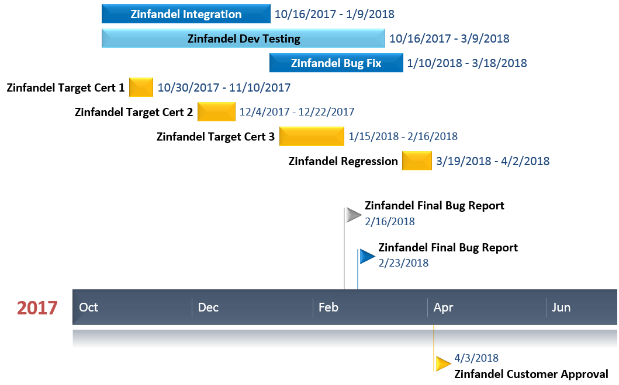
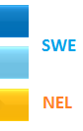
STB – NEL Test Schedule
*Schedule for 2018 still subject to change

Slide 63
CPE E2E – Interactive App Test Team
Jerome Ronquillo, Danilo Resurreccion

Slide 64
CPE E2E Interactive App Test
Overview:
End-User application UI testing with all qualified STB models across current/upcoming STB middleware releases.
High-Level Test Cases
APP UI/functionality
App streams launch and appear with all qualified STB’s
Info Banner from App appears as specified
Customer Facing Error OSD’s in the UI appear as specified
Trickplay Bar appears/suppressed as specified
ABR Feature - App UI/streams still function as expected
Specified Font appears in app
App UI elements appear as expected for DCDP Restart Feature
Application Consistency with STB Middleware
App behavior is consistent on all qualified STB models
Application operation does not cause STB lockup/reboot at anytime
During Application Use - Number Keys/Channel Up/Channel Down: trigger channel tune
During Application Use - Trickplay Buttons (Pause, Stop, Play, Rewind, Fast Forward, Record): function as specified
During Application Use - Native UI Buttons (Guide, Active, List, Exit, Back, Menu, Info, Previous, Dash, Enter): function as specified
Out of Scope
HE related testing (i.e. validating PDS, AS, CDN)
Middleware feature testing (i.e. CATO)

Slide 65
Sample Bullets
Test Environments
E2E Interactive Environment - dedicated APG and iTV headend, specific for Interactive App UI testing
System dedicated to Interactive App UI testing, Note: isolated from other E2E systems
Will need DCDP specific channel configuration
Will need a hardcoded PDS Response
No access to E2E HE Test Systems (i.e. PDS)
Testing Schedule only dependent on handoff from Interactive Dev and/or Frequency Dev.
E2E HE Environment
Need approval from E2E Functional/Performance and/or Iteration stakeholders
E2E Interactive Testing window limited to environment availability
STB Models
Genie Servers: HR44-200/500/700, HR54-200/500/700, H44-100/500, HS17
Genie Clients: C41-100/500/700, C41w-100/500, C61-100/500/700, C61k-700, C61W-400, C61W-600, C61R1 -100, C61R2-200, C61R1-500
Testing Intake Requirements
Application Build Versioning
Bandwidth Specifications for Application

Slide 66
DCDP 2018 SDR Presentation
E2E Functional
Srinivas Chenna/Rishabh Chandra

Slide 67
Agenda:
Changes in-scope for the 2018 Solution
Assumptions
Dependencies
Unsupported Capabilities
Questions

Slide 68
E2E functional Scope- live In Scope: Live
E2E shall test OTT live channel workflow along with live streaming features on one of the supported STB model.
E2E shall test the following features on OTT live channels
DRM
E2E shall test content processing infrastructure by DFW for DRM encryption on DCDP channels which are shifted from satellite distribution to OTT distribution.
E2E shall test playback of DRM encrypted live content on STB
Notes:
DRM- Section 5.5.1
Ad Insertion- Section 1.1 , Section 4.8

Slide 69
Continued..
Ad Insertion
E2E shall test integration of DFW ad insertion platform in support OTT delivered content.
cDVR
E2E shall test content recording via DFW's cloud DVR for new OTT streams
Genie server setup for recording and playback using cDVR
Closed Captioning
E2E shall test closed captioning on OTT delivered content
Notes:
Note: E2E will not test CATO and Reporting requirements.
cDVR- Section 4.7 , Section 1.1, Section 4.2
Closed captioning – Section 4.9

Slide 70
In Scope - VOD
E2E shall test VOD workflow of DTV Now VOD content
Streaming VOD and/or discovery of OTT channel with VOD content
Integration of the DFW content management infrastructure and the satellite content management infrastructure to support VOD
Delivery of VOD content URL to DCDP clients
Display of VOD OTT catalog data on STB and indicate that the content is being hosted by DFW and the URL referencing the content.
Notes:
Section 1.1, Section 4.3, Section 4.5, Section 5.3

Slide 71
Assumptions
No impact to Mobile workflows (VOD & Live Streaming)

Slide 72
Dependencies
iTV Head End should be configured & working in EE
Specifically this includes: iPackager, iStreamer, ISS, UTPS (configuration), DTSS (channel configuration), and APG (channel configuration which DTSS should feed).
BAU workflows should work properly including Stable DASH playback on STB.
Components with integrated changes shall be delivered to us prior to iteration start date
All dependencies should be closed prior to E2E iteration start date.

Slide 73
Out of Scope
CATO
Recording via cDVR of OTT VOD channels

Slide 74
DCDP 2018 SDR (Monitoring)
Advanced Technical Services
Tooling Architecture and Lifecycle Management
Leo Anderson

Slide 75
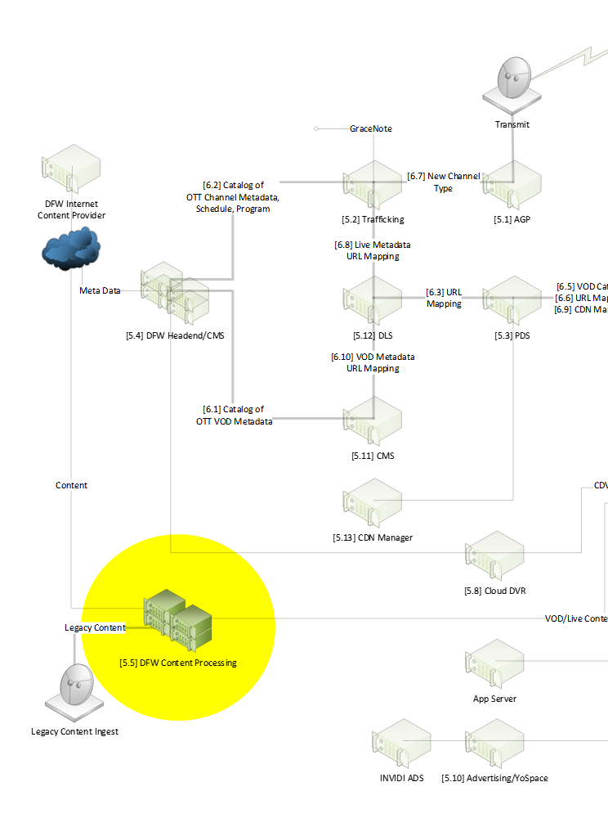
Monitoring - Content Processing (Live Video )
Tool Functions:
Dataminer: Monitor content processing in datacenter, MoM, Harmonic
No Impact
Ineoquest iVMS: Ineoquest controller
No Impact
Ineoquest Inspector: Video quality pre/post encoder
No Impact
Ineoquest Surveyor: Network QoS for video
Video chunk CDN request verification
Ineoquest Dialogue: Passive network TCP monitoring
No Impact
Harmonic VOS: Monitors Harmonic Encoder/Packager
No Impact
Splunk: Log aggregation, parsing, and dashboarding
Status: 20%
Target Completion Date: 7/1/2017
IDS Virtual Client: Manifest checking in lieu of Ineoquest Surveyor
Video chunk CDN request verification
Ineoquest PLM: Program Lineup Manager
CMDB: Configuration Management Database
Correlation work will be required for existing Service ID (Harmonic) to the STB URL
NOTE: Will need further investigation on capacity impact to Moogsoft (Manager of Managers)

Slide 76
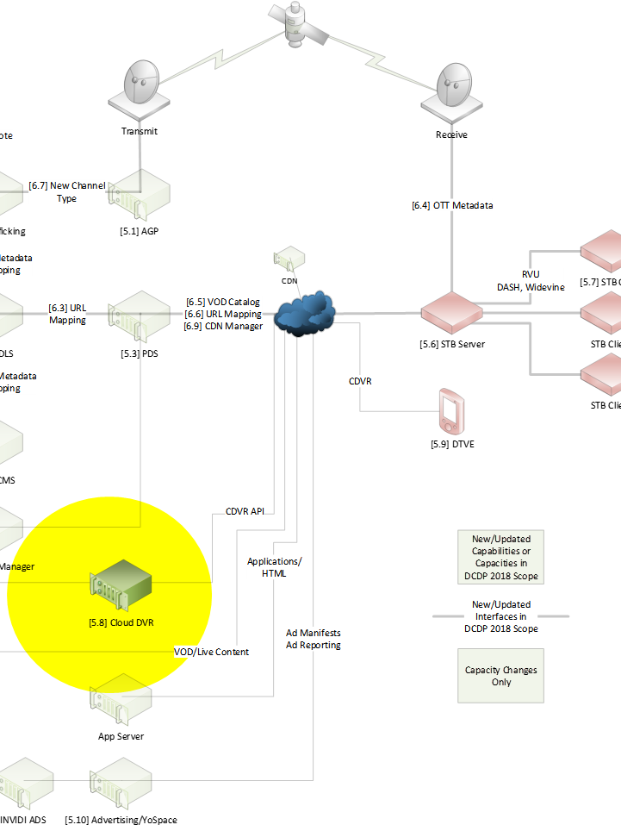
Monitoring - cDVR
Tool Functions:
ELK: Cisco tool to monitor cDVR performance
No Impact
Sensu/Uchiwa: VM, Hardware, monitoring, alerts, logging and visualization
Capacity concern relating to STB clients
Verification of Cisco to monitor (CA) encryption
Recommend using CiscoABRE instead of Widevine (Discussion)
Splunk: Log aggregation, parsing, dashboarding
Addition clients may impact licensing (logging)
Grafana: Dashboard with time series, widgets, plugins
No Impact
OpenTSDB: Scalable time series DB maintains granularity
No Impact
Prometheus: Time series queries, plotting, alerting
No Impact
Dynatrace: Quality of User Experience
No Impact
Scripting for STB client
NOTE: Will need further investigation on capacity impact to Moogsoft (Manager of Managers)
Notes:
6/12 Jeff Holsinger following up for update on Sensu
Splunk(yawl) not included. Need more clarification from Jeff.

Slide 77
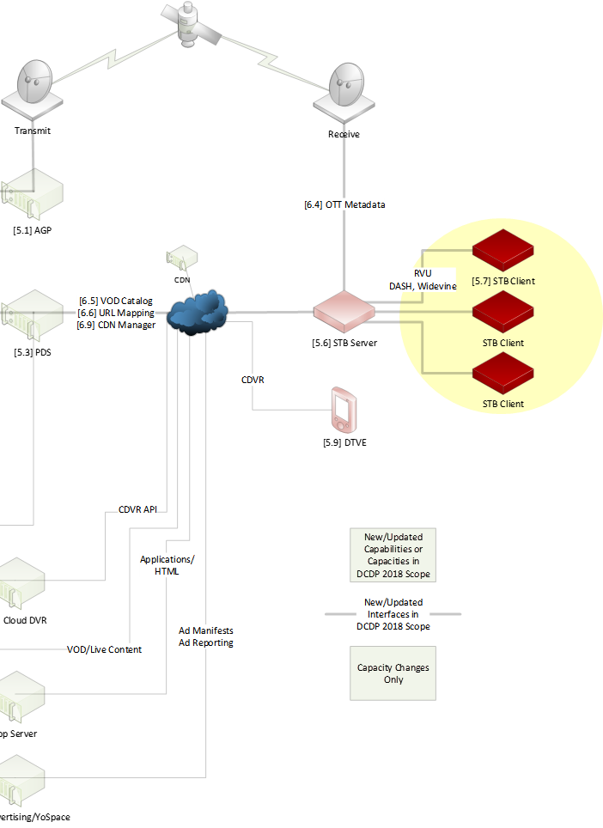
Monitoring – Ad Insertion
Tool Functions:
Isilon: Vendor tool for Isilon storage monitoring
STB Clients will impact storage
Nagios: Monitors systems, networks, infrastructure
No Impact (Verify YoSpace SDK Operation)
Prometheus: Time series queries, plotting, alerting
STB Client Capability Verification
STB Ad content specifications
CALM Act Compliance
Ad Trigger Verification
Ad Break Verification
Commercial Break Patterns Verification
Target Completion Date: 7/25/2017
OpenTSDB: Scalable time series DB maintains granularity
No Impact
Grafana: Dashboard with time series, widgets, plugins
No Impact
Dynatrace: Quality of User Experience
No Impact
Scripting for STB client
Notes:
6/12 William Hodge working with Adrian Moore and Walter Murcia to acquire updates
Isilon shows up on spreadsheet, but on diagram
OpenManager shows up on diagram, but not on spreadsheet

Slide 78
DCDP 2018 SDR
CPE E2E Performance Test
Abhijit Agashe

Slide 79
Key Objectives and Goals of Performance Testing
The Primary objective of this test effort is to evaluate the performance of MCN/Digital Content Delivery Platform 2018 project on projected load and validate if the performance test cases are meeting the SLA’s
Analyze the resource utilization and identify any inconsistencies during load/performance test executions and report them to the project team.
Prepare the detailed performance test reports which will provide inputs to the Network, development and operations teams to determine the production load capacity for this project.
Performance Testing will include Load, Stress and Endurance.
Performance Testing Activities include Test Planning, Test Executions and Test Reporting.
Performance Testing team will provide the Test Metrics for all the tests executed.

Slide 80
E2E Test Environment Assumptions
E2E is a 20% scaled down environment with respect to Production POP unless otherwise specified.
E2E will be enhanced with the new components to support the new features for this project.
The existing components will be upgraded with the current Iteration numbers as necessary to run this project’s performance test scenarios.

Slide 81
Performance Testing Scope
We will be testing the use case scenarios with load, stress and endurance tests
S. no. | Scenarios | Impacted Applications | Performance Test Scope
1 | VOD Catalog | PDS | Yes
2 | URL Mapping | PDS | Yes
3 | CDN Manager Proxy requests | PDS | Yes
4 | Ad Infrastructure Capacity to support DCDP channels | TBD | TBD
5 | CDN Manager capacity increase | TBD | TBD

Slide 82
Scenarios & Load Numbers
Scenario | SLA in Prod | SLA in E2E | Test Types
VOD Catalog | TBD | TBD | Load, Stress, Endurance
URL Mapping | 1000 TPS | 100 TPS | Load, Stress, Endurance
CDN Manager Proxy requests | 1000 TPS | 100 TPS | Load, Stress, Endurance
Ad Infrastructure Capacity to support DCDP channels | TBD | TBD | TBD
CDN Manager capacity increase | TBD | TBD | TBD

Slide 83
Dependencies
S. No | Dependency | Owner | Need by Date
1 | EE Environment Setup as per the scalability factor (20% of Production pop). | CI/CD | Before Pre-validations( as per iteration timelines)
2 | Components to be fully sub-system tested & integrated prior to E2E test start date | Sharma Neerad / Aravind Subhash(Iteration Lead) | Before Pre-validations
3 | Need confirmation on the SLAs for identified scenarios | SE | Before Test Planning (based on Iteration timelines – 8 weeks before Environment handoff)
4 | Need flow diagrams identifying the sub-systems involved for the scenarios identified | SE | Before Test Planning (based on Iteration timelines – 8 weeks before Environment handoff)

